Slide 1

cad
#2

Slide 2
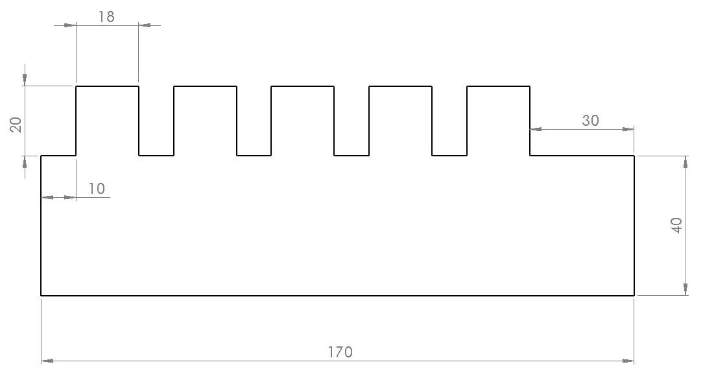
Gambar 1

Slide 3
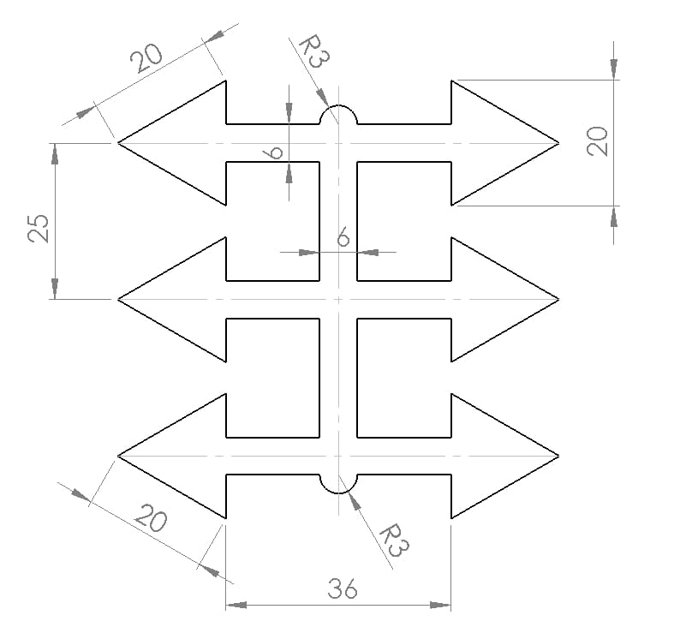
Gambar 2

Slide 4
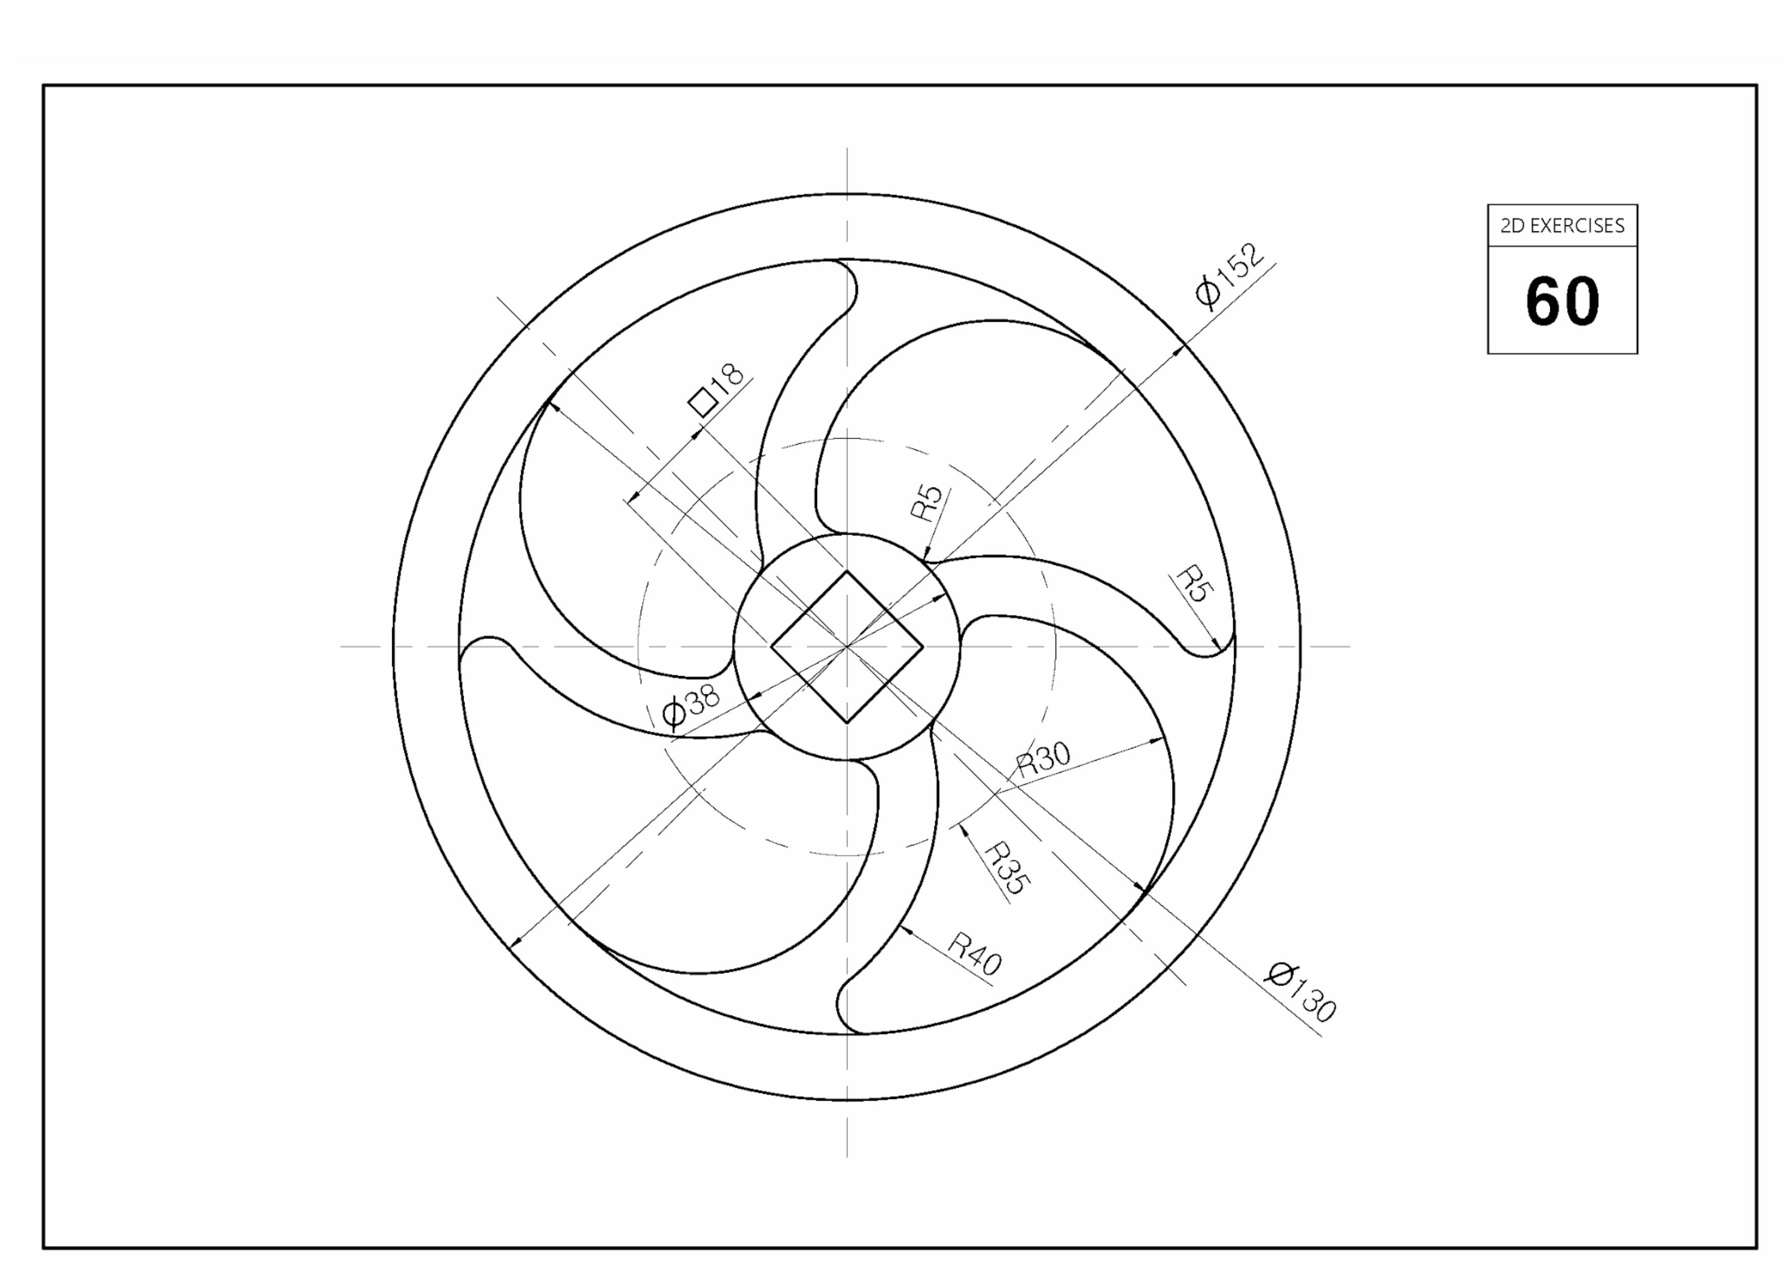
Gambar 3

Slide 5
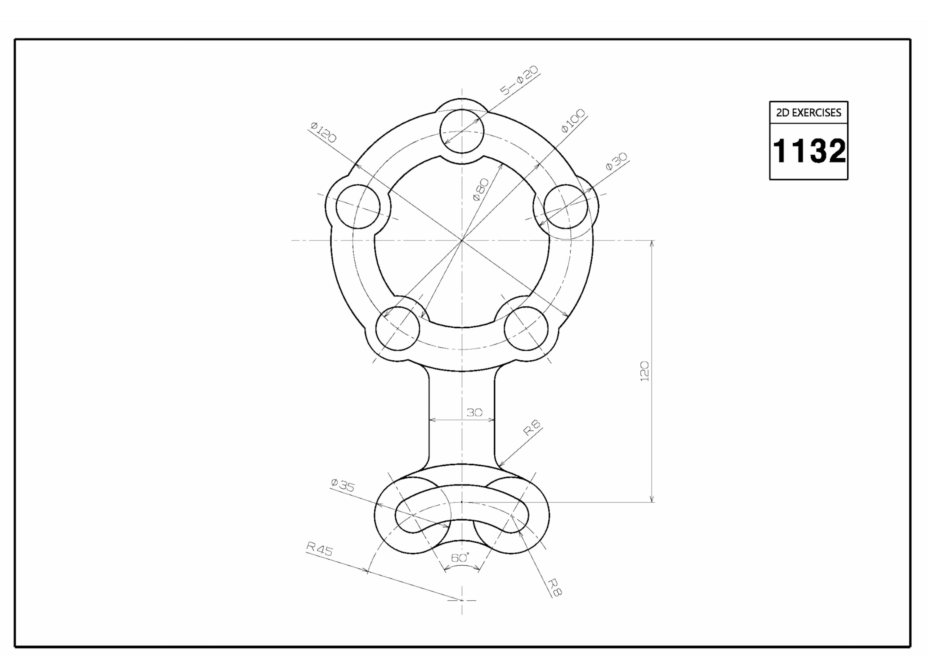
Gambar 4

Slide 6
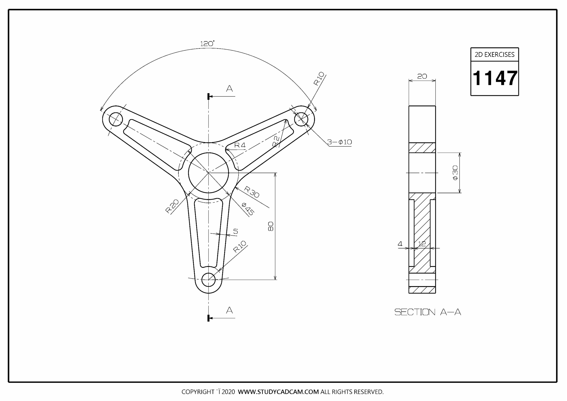
Gambar 5

Slide 7
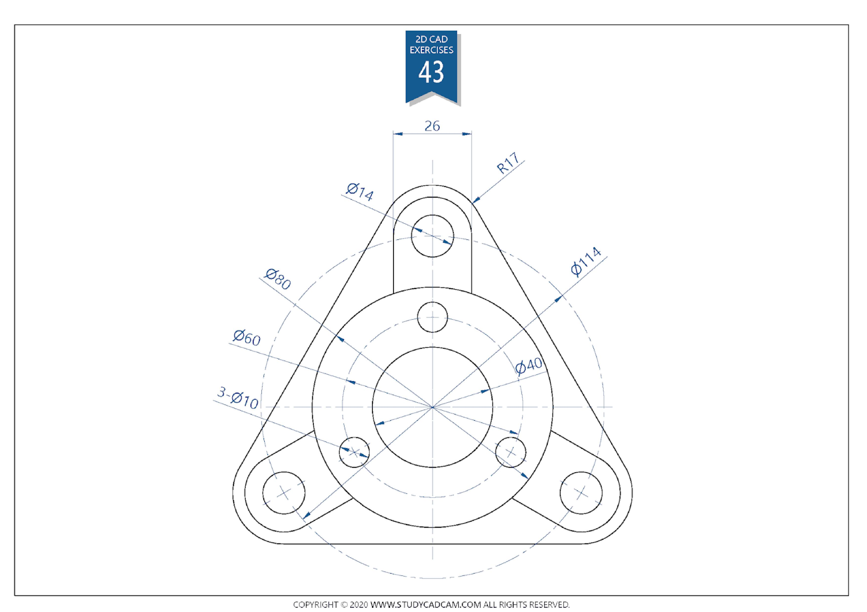
Gambar 6

Slide 8

Thank you
- baren

